Slide 1
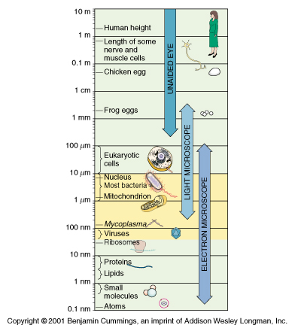
Relative Sizes of Organisms
Human ~ 2 Meters
Egg ~ 400 cm
Frog eggs ~ 2 mm
Eukaryotic cells ~ 10-100µ
Bacteria ~ 1-25µ
Mitochondrion ~ 1µ
Viruses ~ 40 -100 nm
Ribosome ~ 30 nm
Proteins ~ 3-10 nm
Molecules ~ 0.5 - 1 nm
1 meter = 10² cm = 10³ mm = 10⁶ μm = 10⁹ nm

Slide 2
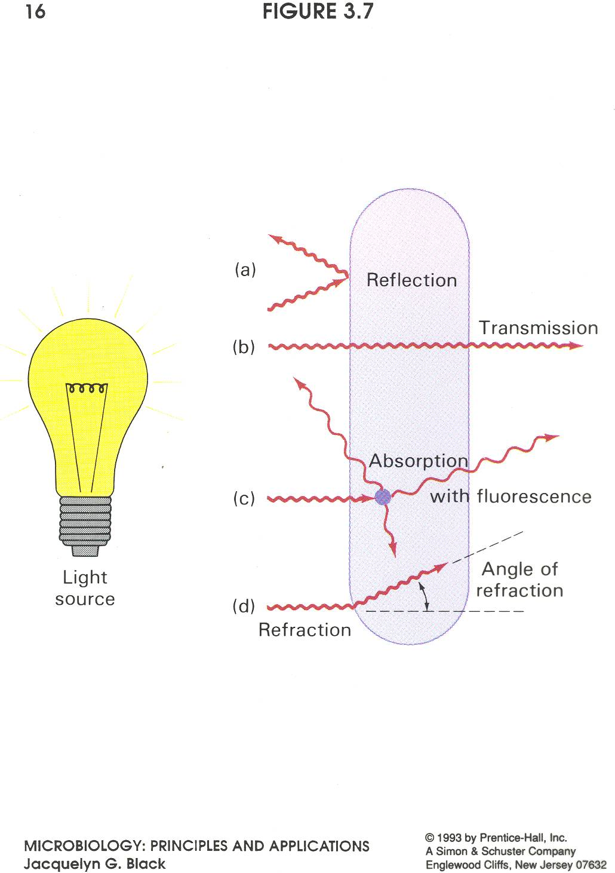

Slide 3
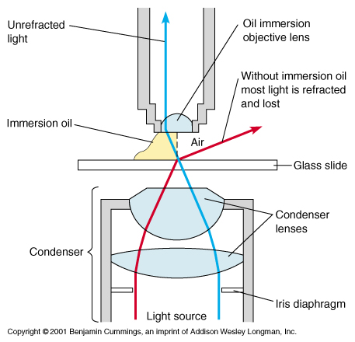
Refraction and Oil Immersion
Refractive Index –
the ability of a medium to
bend light
Maximum Magnification =
1500 X
Limited by the wavelength
of visible light

Slide 4
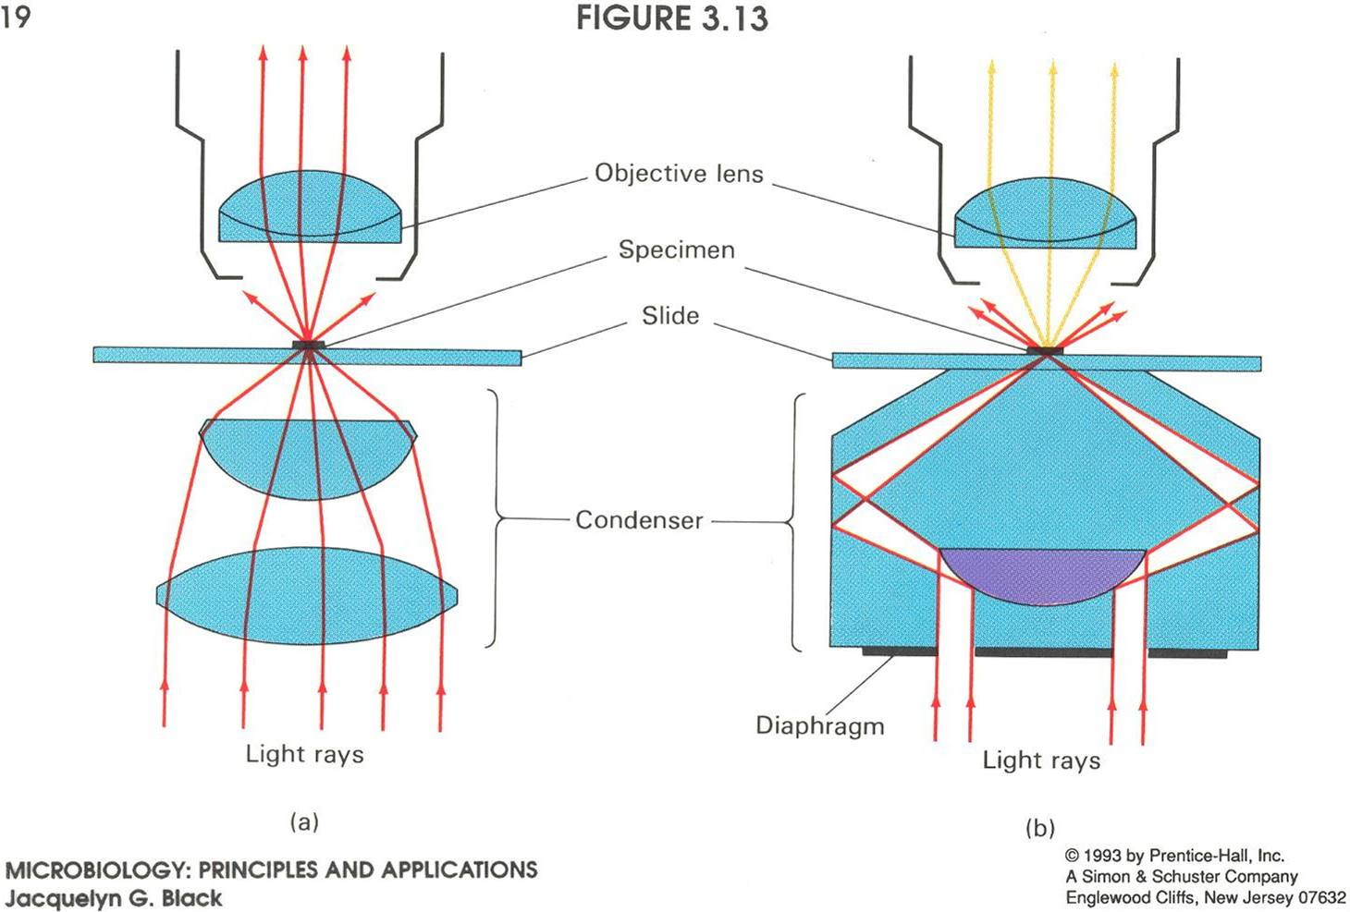
Bright field
Dark field

Slide 5
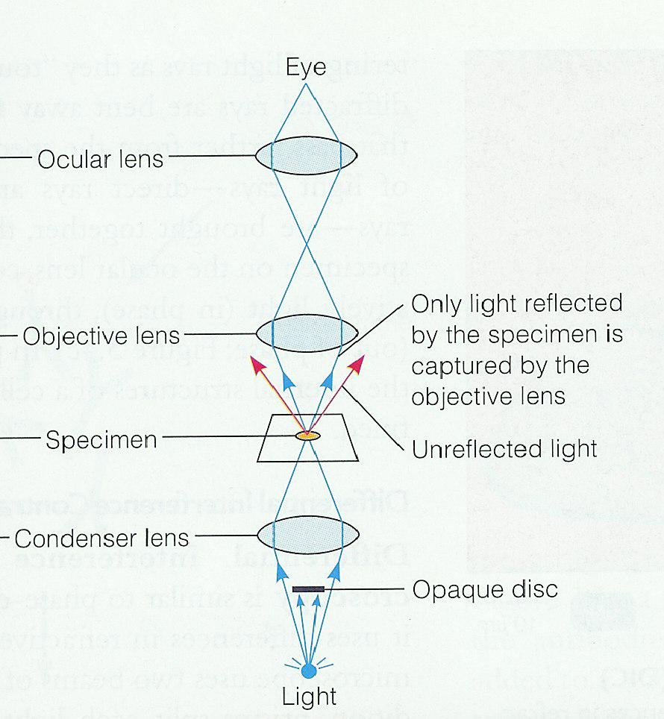
Dark-Field Microscopy
Modified condenser contains disc in center
Only light reflected by specimen can enter objective
Objects surrounded by halo
Advantage - can see smaller objects like spirochetes, internal structures highlighted
Disadvantage - objects look bigger than they actually are

Slide 6
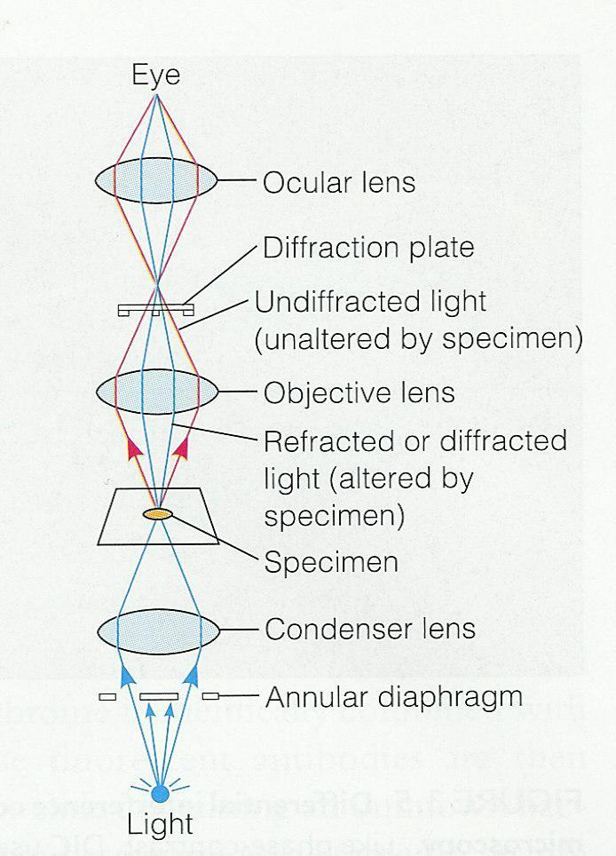
Phase Contrast Microscopy
Light passes through annular diaphram
Causes light waves to become “in phase” or synchronized
Advantage - can highlight internal cell structures and details
Disadvantage – none

Slide 7
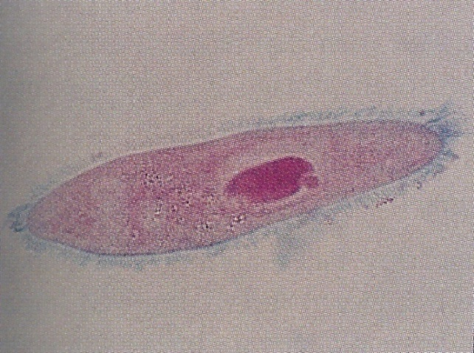
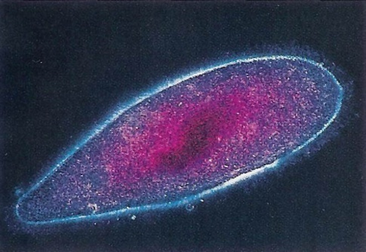
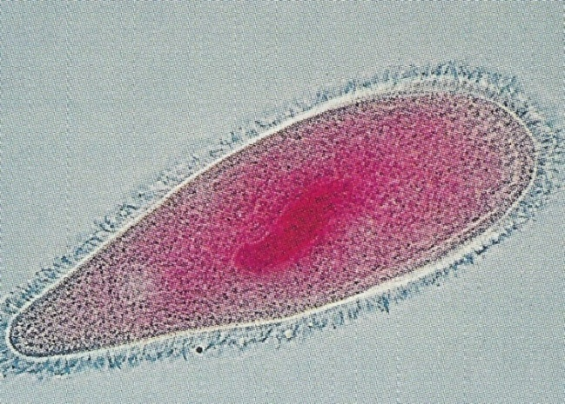
Comparison of Light Microscopy
Bright field
Dark field
Phase Contrast
2
3
1

Slide 8
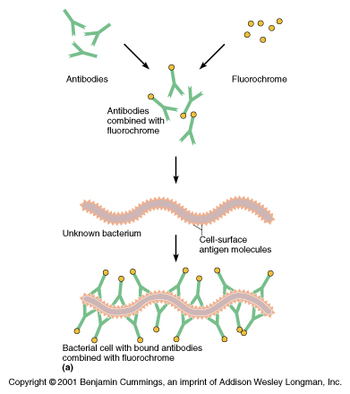
Immuno Fluorescent Technique
Fluorescent tag (fluorescein) conjugated to Antibodies
Antibodies bind to surface of bacteria
Illuminate with specific wavelength of light (FITC- excite with blue, fluoresces green)
Observe with fluorescence microscope
Used with syphilis spirochete and other organisms

Slide 9
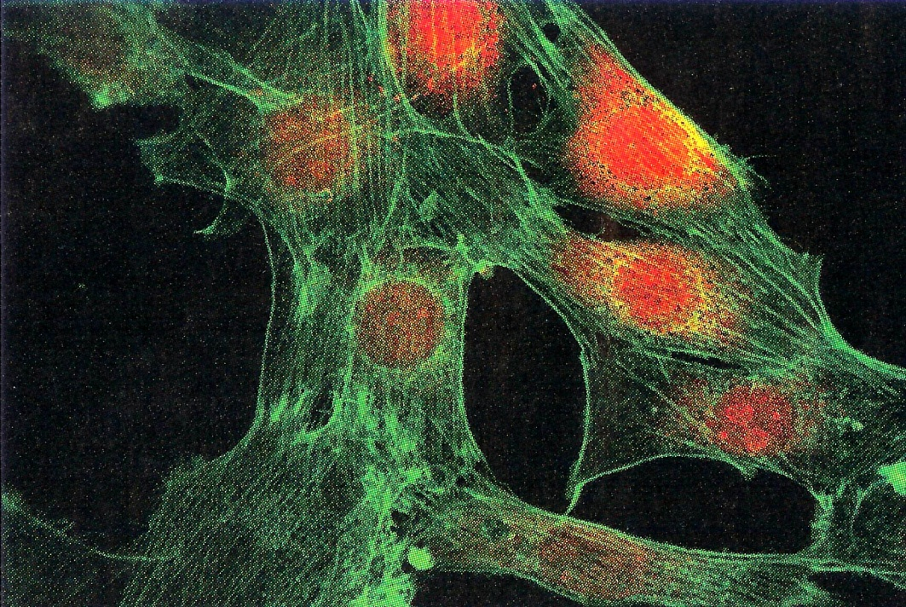
Confocal Microscopy
Uses Fluorescent tags; multiple colors
Optics allow one to view one plane at a time- no background fluorescence
Computer can “section” specimen one plane (20nm) at a time and re-assemble planes into a 3D image
Used much in Cell Biology and Anatomy

Slide 10
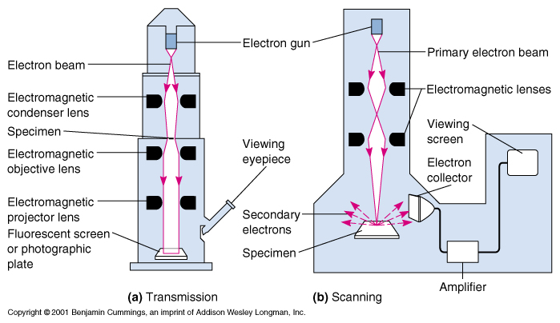
Electron Microscopy
Uses electron beam in place of light
Magnification up to 100,000 X
Transmission EM shows very fine detail
Scanning EM looks 3D
Disadvantages –
non-living specimen, much processing

Slide 11
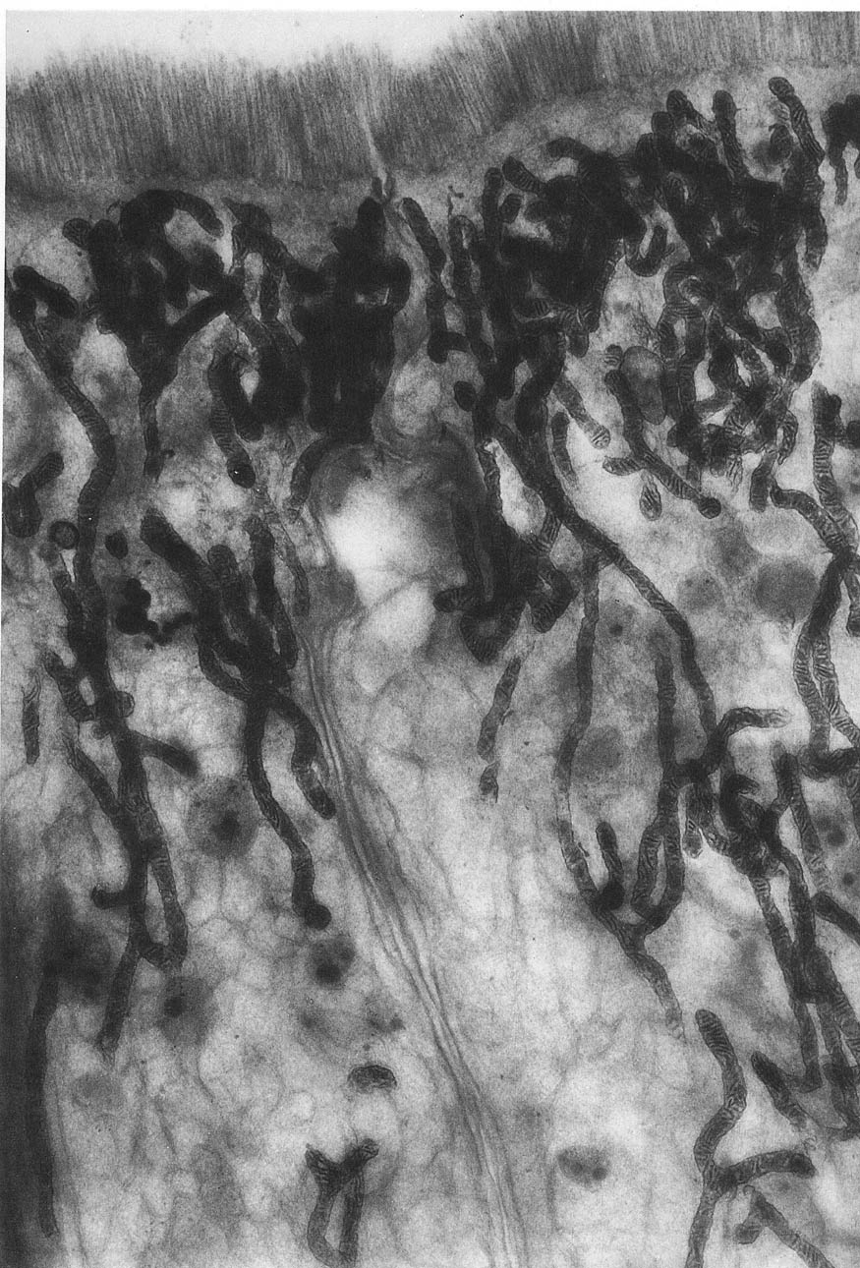
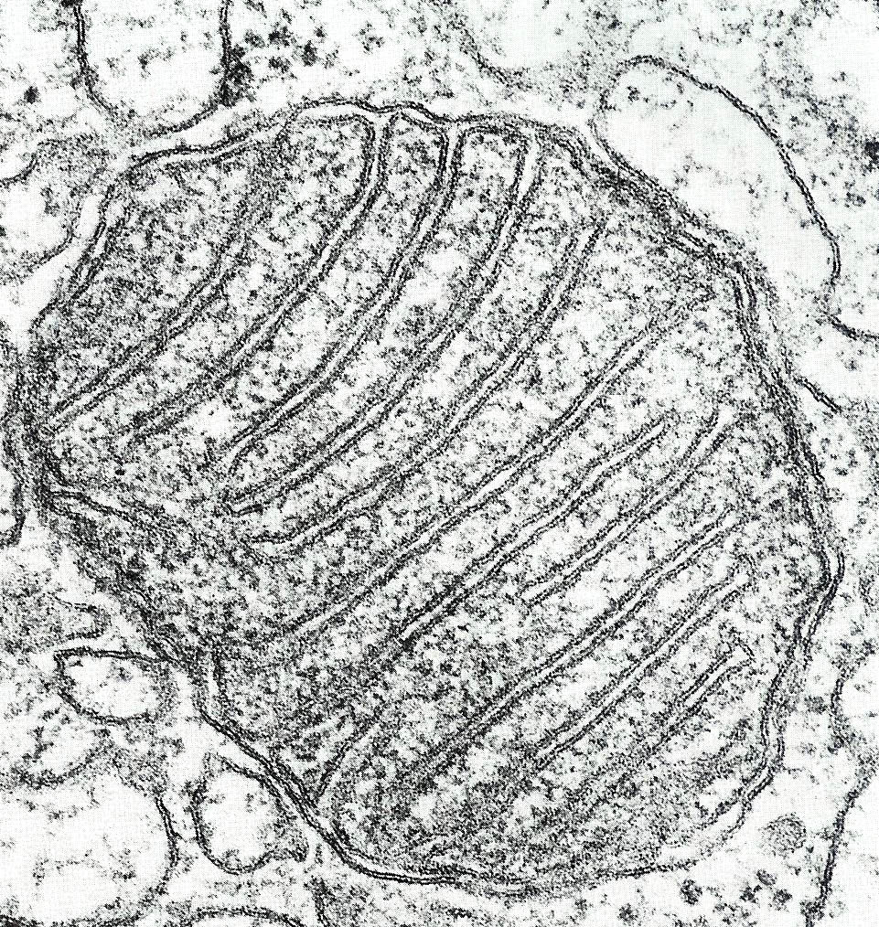
Transmission Electron Microscopy (TEM)

Slide 12
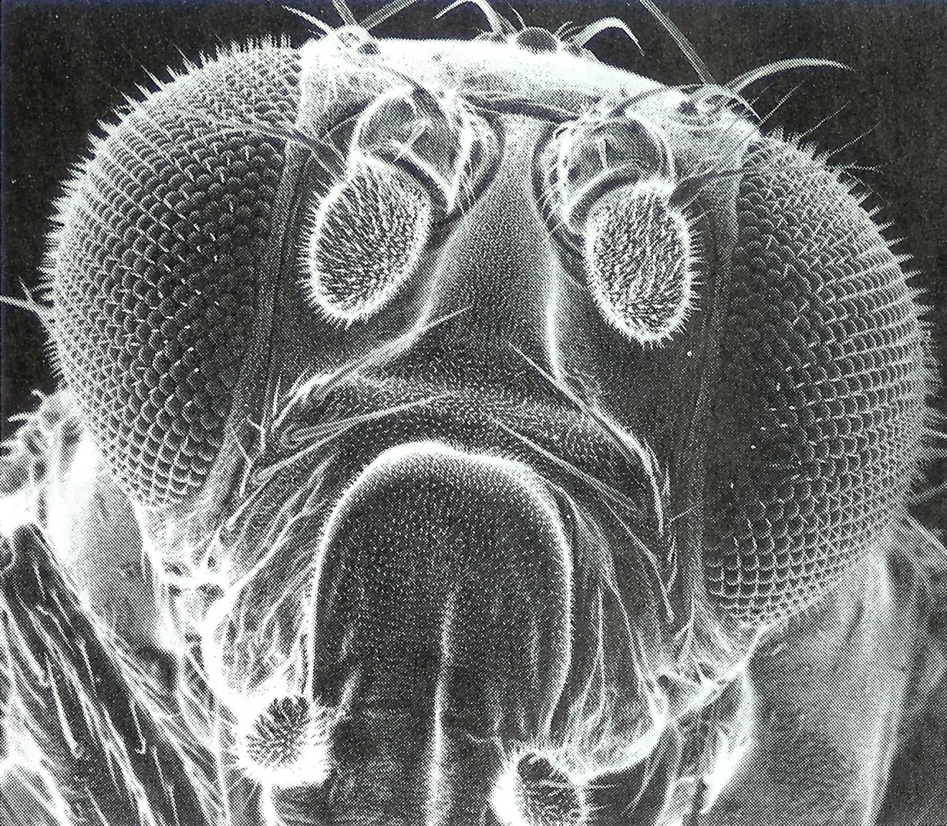
Scanning Electron Microscopy (SEM)

Slide 13
Comparisons of Light Microscopes with
Electron Microscopes
Compound Light Microscopes Maximum magnification with resolution 1,000X
  Modifications of condenser
    Bright field
    Dark field
    Phase Contrast
    UV Fluorescent Microscopy

Slide 14
Electron Microscope
Use electron beams focused by magnets and projected on a video screen. Smaller defining source = greater resolving power
Transmission Electron Microscope (TEM) magnifications over 500,000 X. Ultra structure of bacteria observed. First time viruses observed
MOST POWERFUL OF ALL OF THE MICROSCOPES USED FOR INVESTIGATION

Slide 15
Scanning Electron Microscope
Specimen is coated in such a way as to emit electrons when bombarded with electrons they emit electron energies that are picked up by a collector and a true three-dimension image is presented whereas the transmission (TEM) is only two dimension. Does not magnify images as great as the Transmission Electron Scope

